Slide 1

Design Patterns
A path to Clean Code.
By Ashish Dhyani

Slide 2
Design Patterns
Agenda
Why we need it
How I come across delivering this session

Slide 3
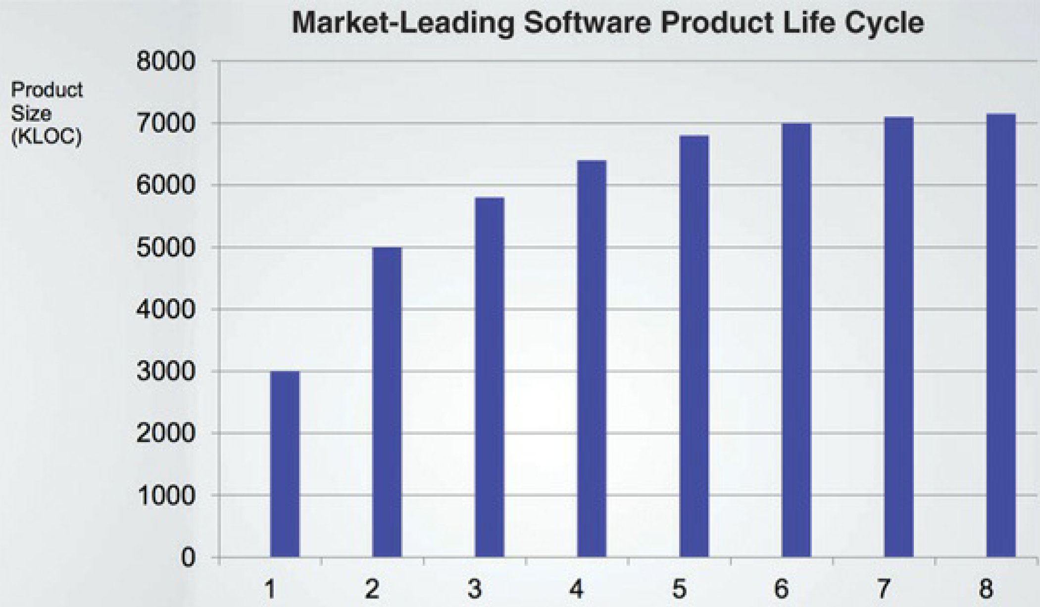

Slide 4
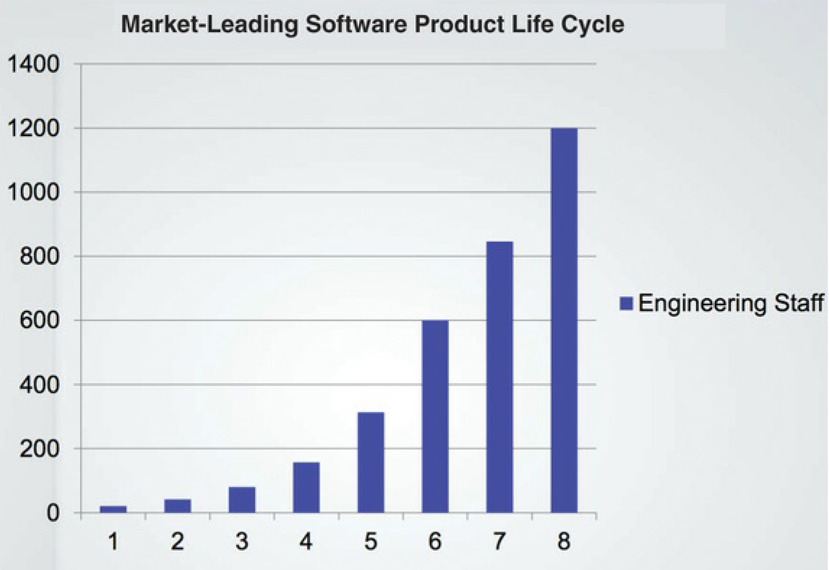

Slide 5
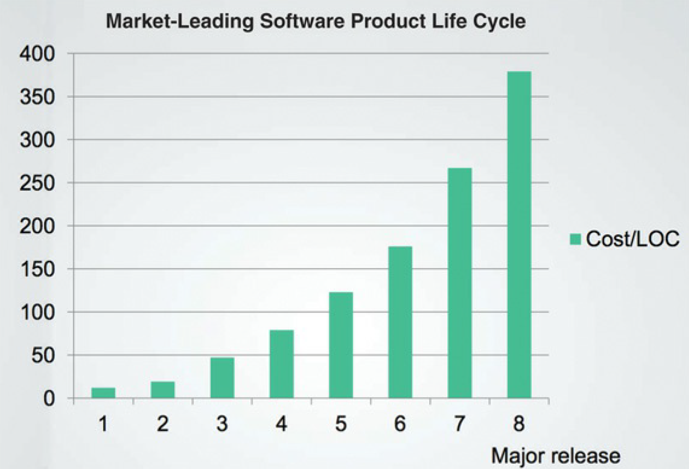

Slide 6
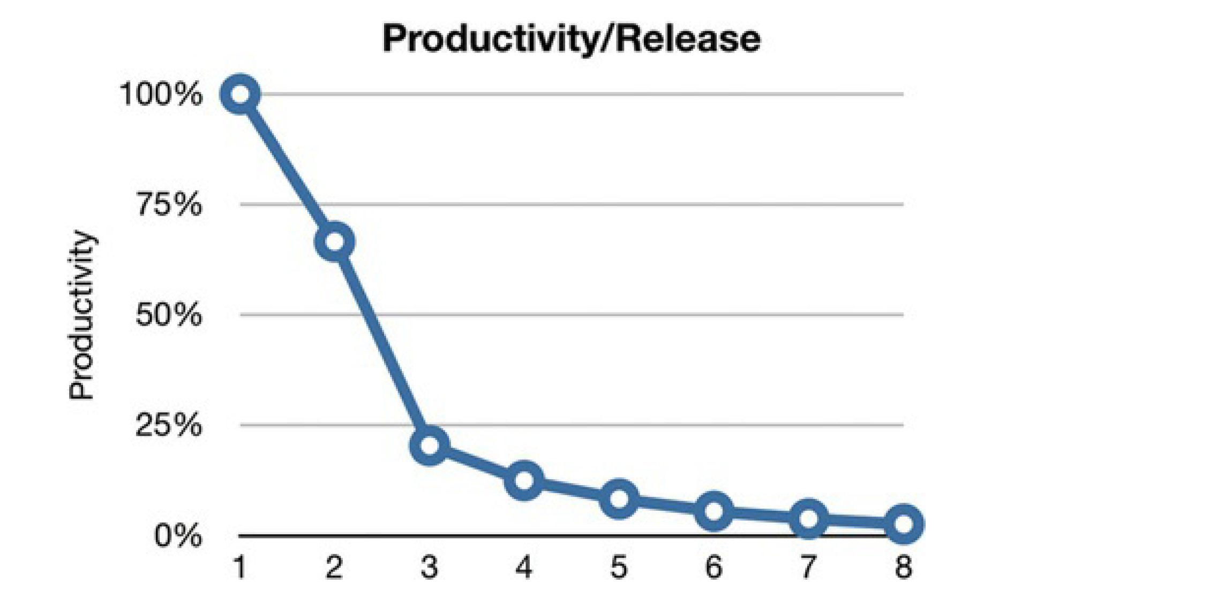

Slide 7

What is the problem?

Slide 8

Dirty Code
Tight coupling.
Bad naming conventions and commenting.
Non optimized handling of objects creations and relationships.
When something changes, need to change at lot of places.
Performance issues.

Slide 9

Clean code
It is a method to write your application in such a way that is least affected due to change

Slide 10
What are the Design Patterns ?

Slide 11

Design Patterns
In software development, a patterns (or design pattern) is a written document that describes a general solution to a design problem that recurs repeatedly in many projects. Software designers adapt the pattern solution to their specific project.

Slide 12
Design Patterns
Creational
Structural
Behavioral

Slide 13
Creational Patterns
Singleton
Factory
Abstract Factory
Builder
Protype
Creation patterns are ones that create objects, rather than having to instantiate objects directly. This gives the program more flexibility in deciding which objects need to be created for a given case.

Slide 14
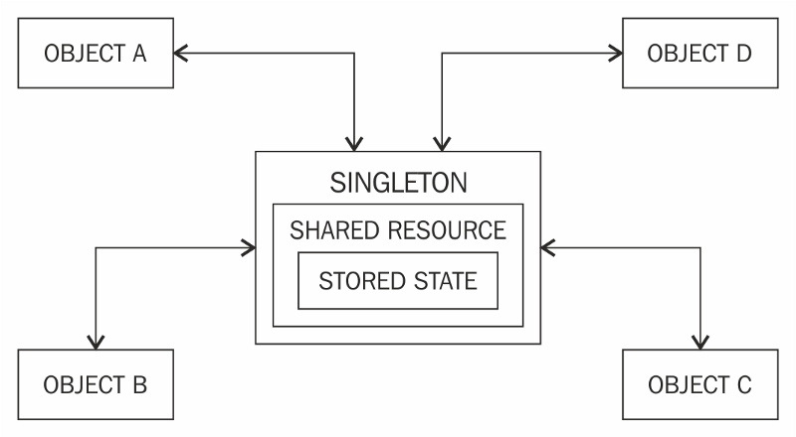
Singleton
Restricts object creation for a class to only one instance.

Slide 15
Singleton VS Static
Singleton = Static + Thread safety + Lazy loading + Capability to pass object as reference

Slide 16
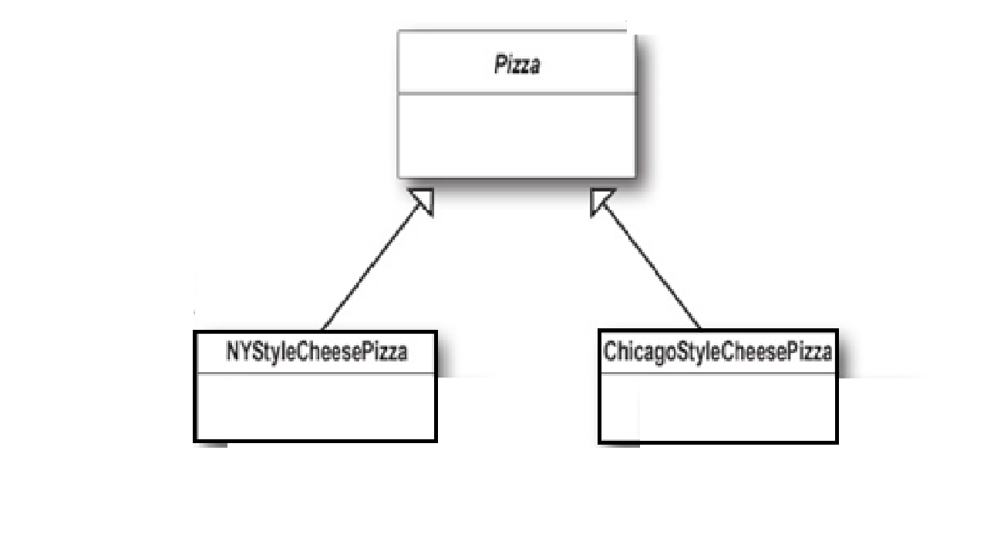
Factory
Factory methods deal with the problem of creating objects without having to specify the exact class of the object that will be created.

Slide 17
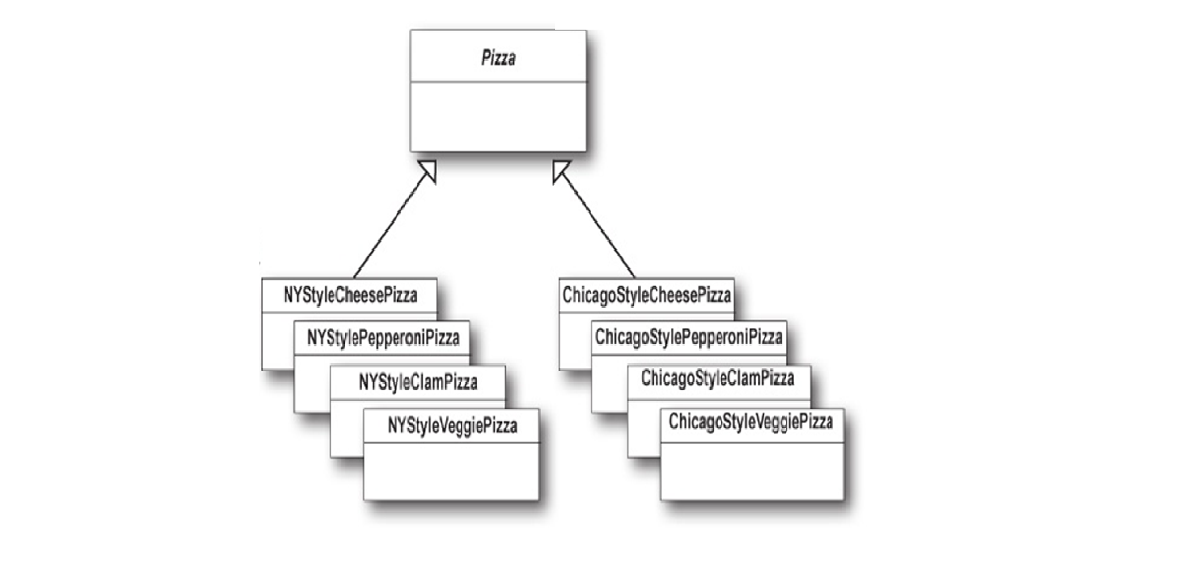
Abstract Factory
The abstract factory pattern provides a way to encapsulate a group of individual factories that have a common theme without specifying their concrete classes

Slide 18
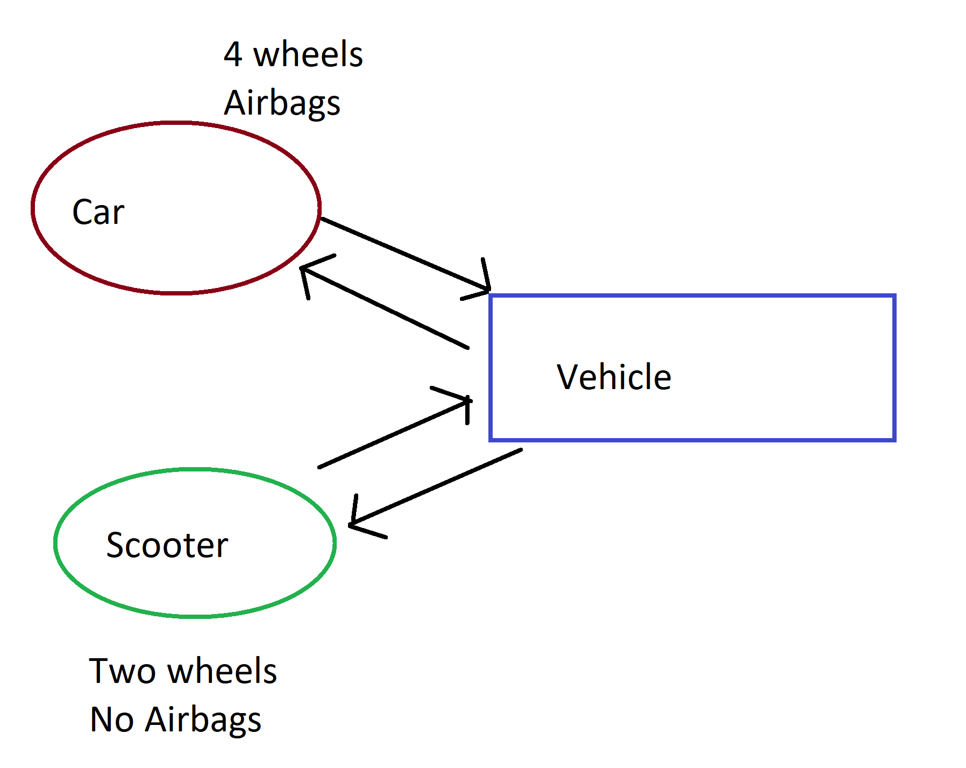
Builder
Constructs complex objects by separating construction and representation.
It provides clear separation between the construction and representation of an object.
It provides better control over construction process.
It supports to change the internal representation of objects.

Slide 19
Prototype
Creates objects by cloning an existing object.

Slide 20
Structural Patterns
Adapter
Bridge
Composite
Decorator
Façade
Flyweight
Structural patterns are concerned with how classes and objects are composed to form larger structures.

Slide 21
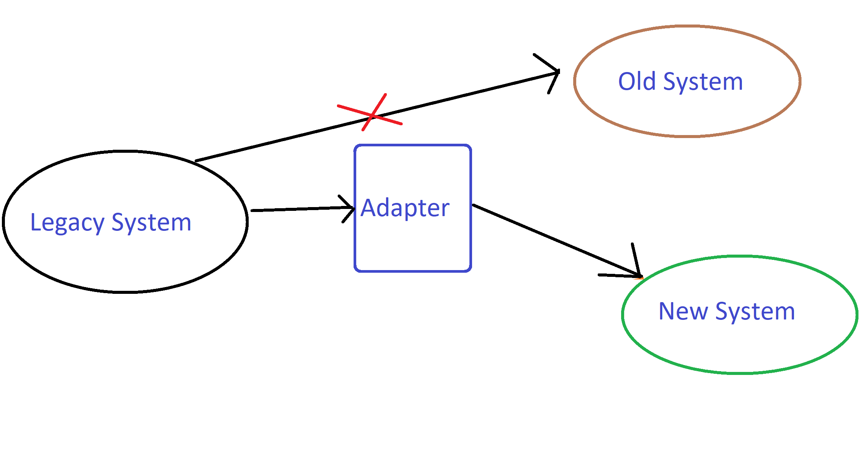
Adapter
Makes two incompatible system work together
It allows reusability of existing functionality.
Makes testing easier

Slide 22
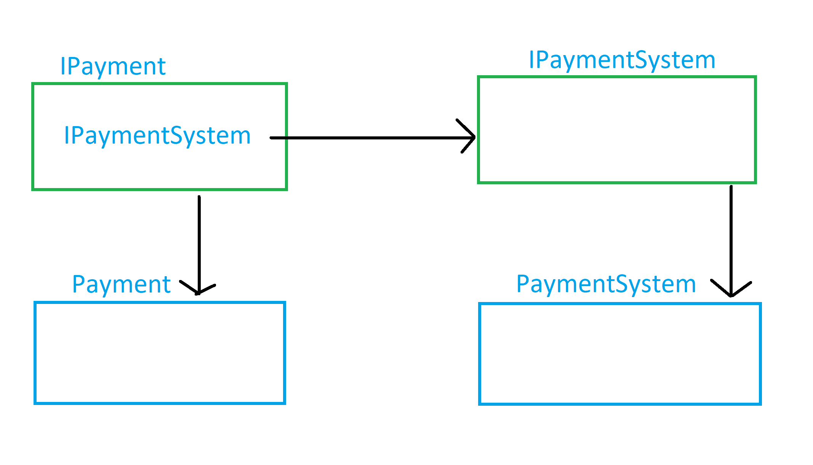
Bridge
Decouple an abstraction from its implementation so that the two can vary independently

Slide 23
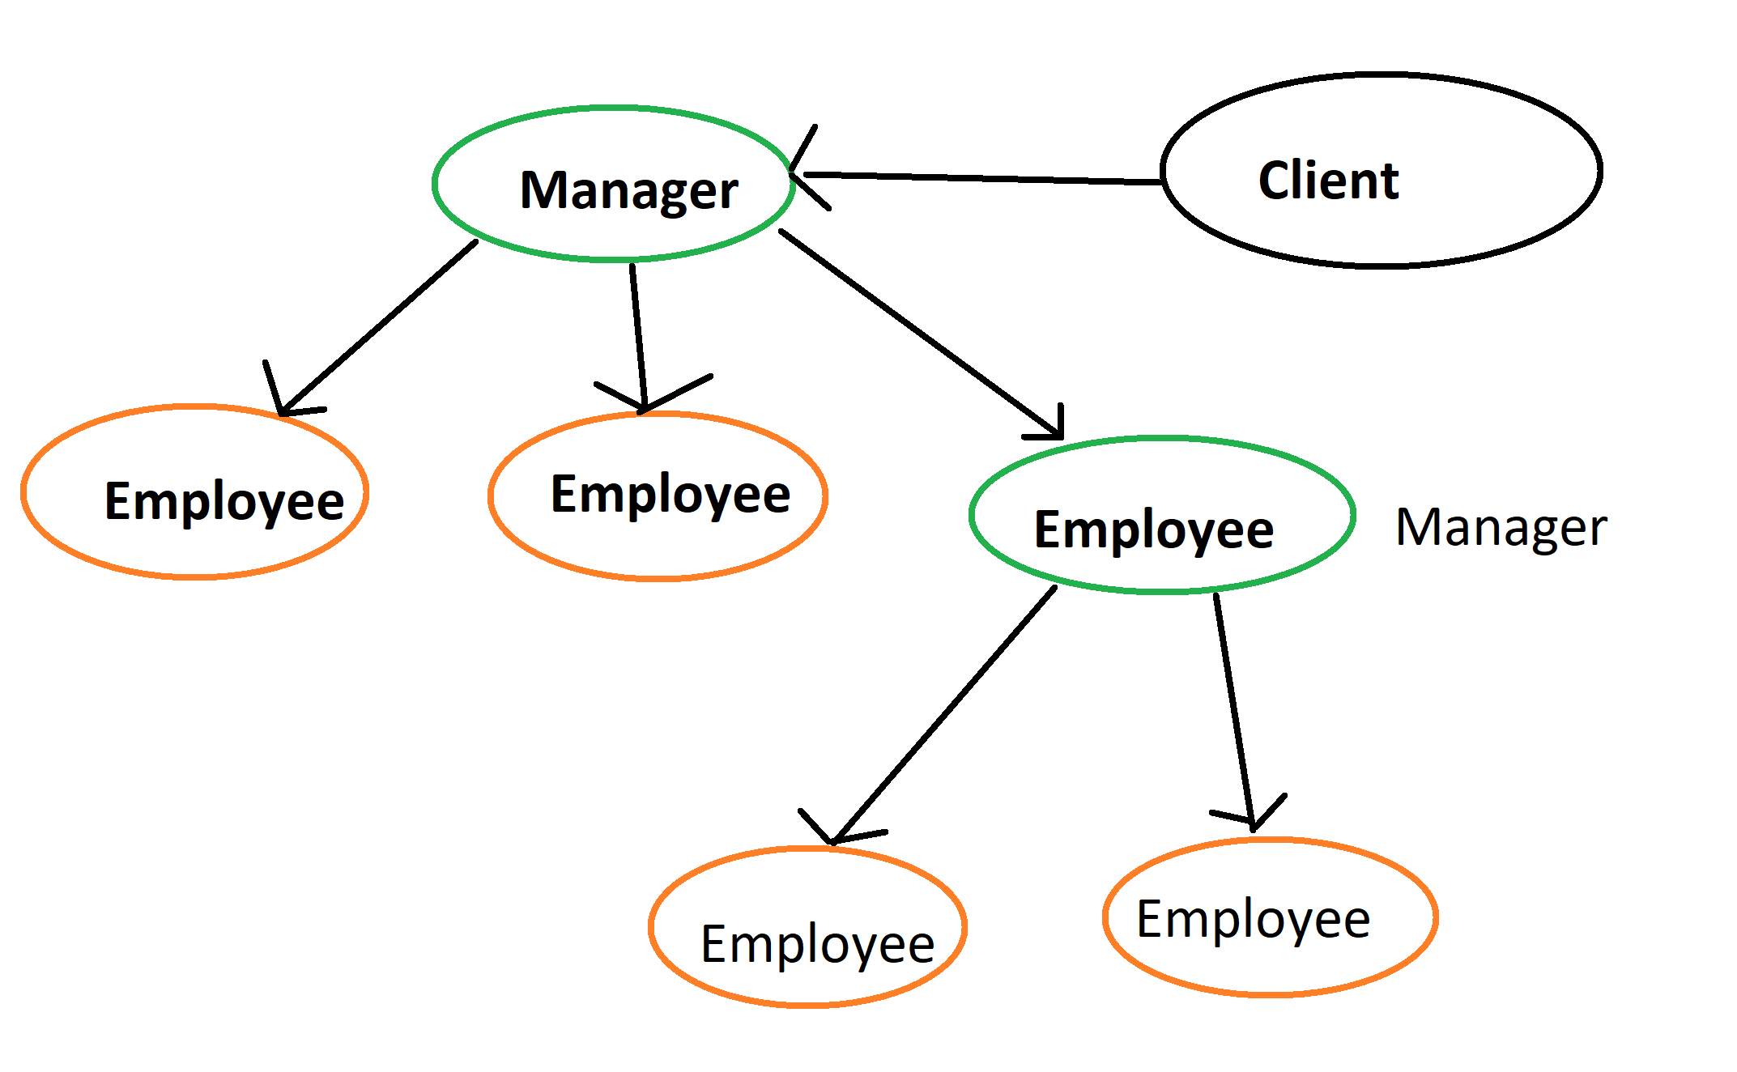
Composite
A part-whole hierarchy should be represented so that clients can treat part and whole objects uniformly.
A part-whole hierarchy should be represented as tree structure.

Slide 24
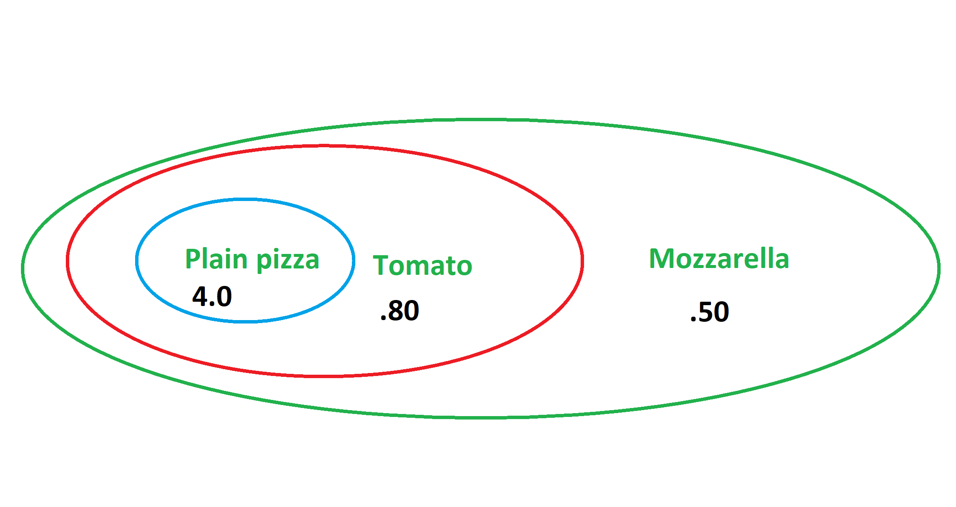
Decorator
Decorator pattern allows a user to add new functionality to an existing object without altering its structure
You don’t have to create many classes.

Slide 25
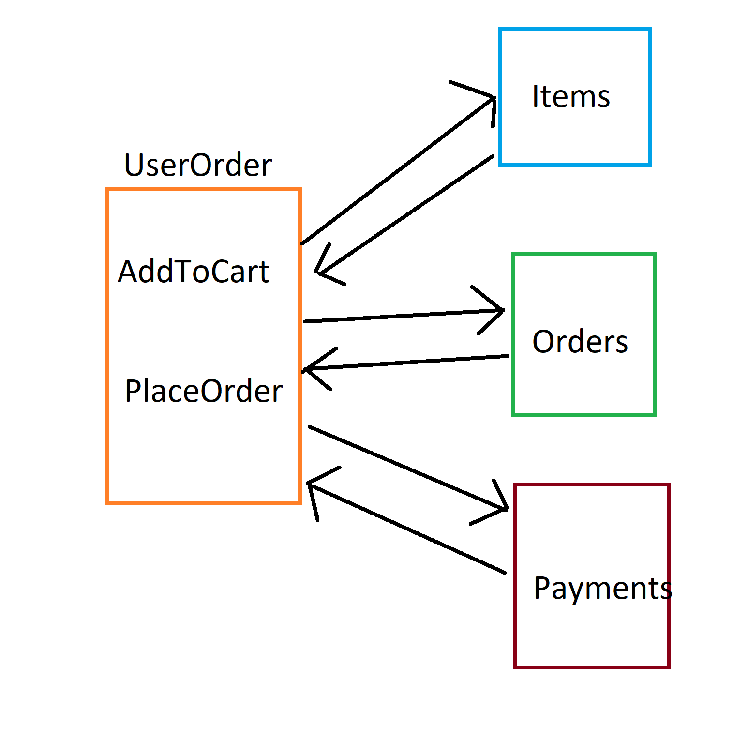
Facade
Make complex system simpler

Slide 26
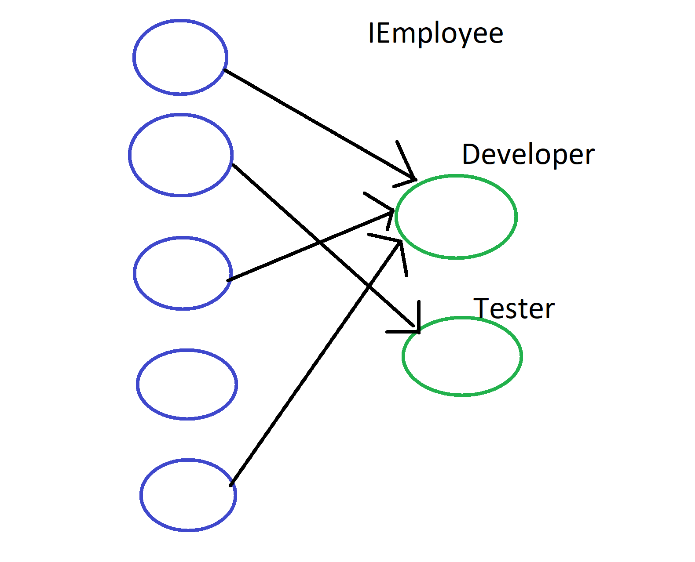
Flyweight
Dealing with large numbers of objects with simple repeated elements that would use a large amount of memory if individually stored.

Slide 27
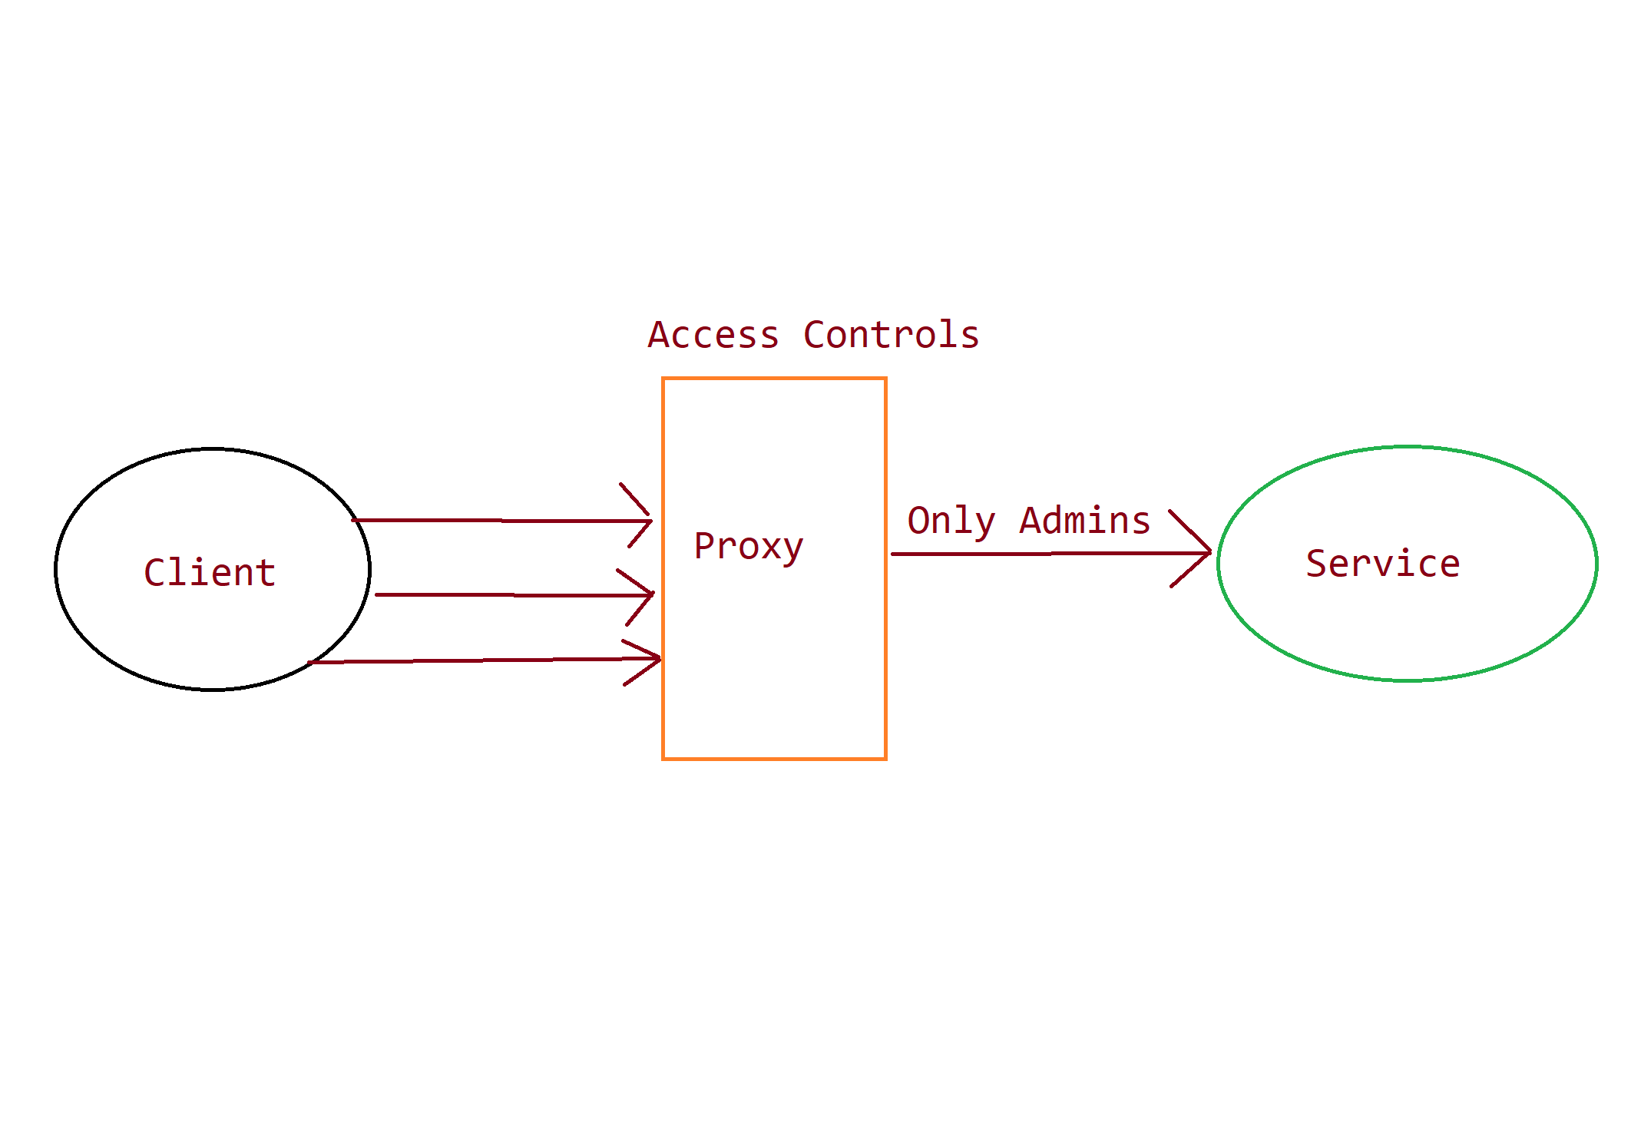
Proxy
Controls and manage access to the object they are protecting

Slide 28
Use cases
We are designing a first-person shooter game. we need to load one of the different family of guns at runtime however hiding the complexity of object creation from the client.
Abstract Factory

Slide 29
Use cases
We like to create a logger class, that should write the logs in the filesystem with thread safety in mind while opening and closing the connection to the filesystem.
Singleton

Slide 30
Use cases
Our legacy system was running for years. We like to change our vendor. New vendor codebase is not exactly compatible with our legacy code. How can we solve this incompatibility problem without changing legacy codebase?
Adapter

Slide 31
Use cases
We are designing a first-person shooter game. we need to load one of the different guns of the same family of algorithm at runtime however we like to hide the complexity of object creation from the client.
Factory

Slide 32
Use cases
We are developing a payment system. We like to use payment gateway inside payment system as an abstraction. Concrete implementation of payment gateway can be passed at runtime.
This brings flexibility in design because.
Payment gateway system can be developed separately.
Any one of the payment gateway family can be injected at runtime.
Bridge

Slide 33
Use cases
We are developing a organization dashboard which should represent relationship between Org employees and their managers in a tree structure. Which design pattern should solve this problem appropriately
Composite

Slide 34
Use cases
We have a complicated design for our ecommerce application. More than 10 functions exists in multiple classes need to be called as part of a confirm order request. Is there a pattern to remove this complexity from client and make our design simpler.
Facade

Slide 35
Use cases
We need to create millions of objects of the same family in a loop. The app runs fine on my system but gets out of memory exception in my friend's machine. What is the issue and how can we improve our design.
Flyweight

Slide 36
Use cases
We are designing a web programming framework. we need to initialize the logging, alerting, monitoring, app settings configurations provided by user at web app startup while hiding the complexity of object initialization from end user.
Builder

Slide 37
Use cases
We are developing a calculator, which provides user the ability to add, sub, div and mul the two numbers. User like to perform all the operations before they see the result. They also like to undo their last operation/s if they have done some mistakes on the go. How can we design such system.
Command

Slide 38
Use cases
We have a function in our ecommerce application that is meant to be used only by admins and super admins. How we can implement these policies without changing this function’s code.
Proxy

Slide 39
Use cases
We like to create a ice-cream shop website. While designing the business objects, we ended up creating tons of classes with slight variation.
Example one for ice-cream with chocolate and one without, one with strawberry's and another without. How can we solve this problem?
Decorator

Slide 40
Use cases
We are developing a new List type which will have different sorting algorithm (BrickSort, BubbleSort) and its display algorithm (single line with space , multiple lines).
Example
If user selects list1 Brick Sort with single line display will be used.
If user selects list2 Bubble Sort will multiple lines should be used.
If user selects list3 Brick Sort will multiple lines should be used.
How can we design such a system while considering code reusability of algorithms
Strategy

Slide 41
Behavioral Patterns
Chain of responsibility
Command
Observer
Strategy
Template Method
Behavior patterns are concerned with algorithms and the assignment of responsibilities between objects.

Slide 42
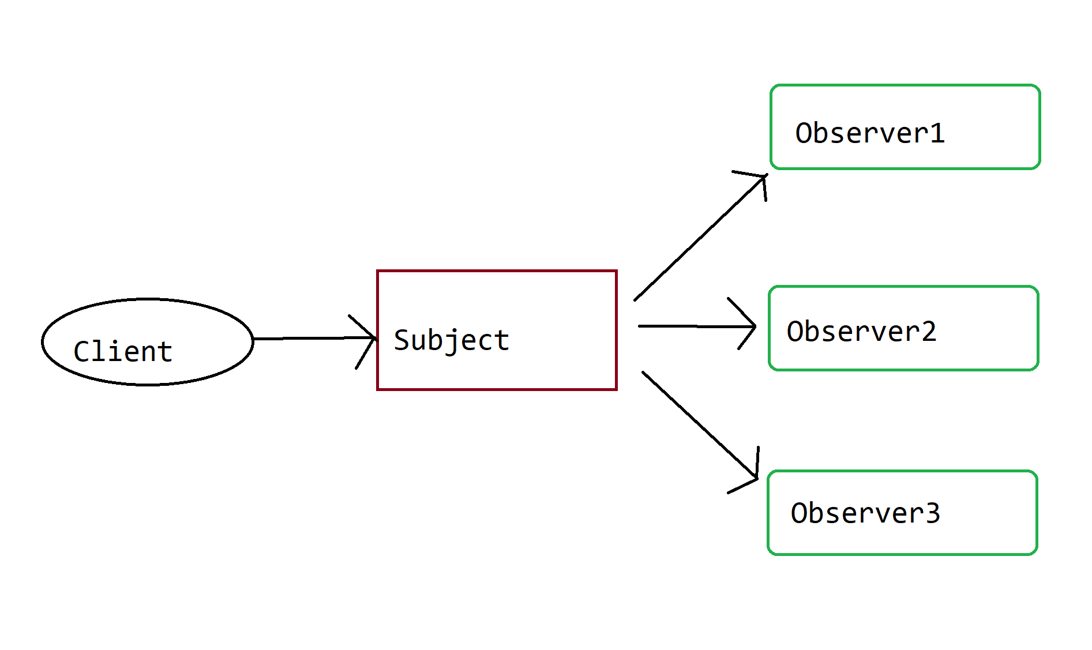
Observer
The observer pattern is a software design pattern in which an object, named the subject, maintains a list of its dependents, called observers, and notifies them automatically of any state changes, usually by calling one of their methods.

Slide 43
Use cases
Observer pattern can be used for developing flexible notification system. We may add new notification type (example email, phone etc.) by subscribing to the notification event/ subject and unsubscribe for removal. Thus, making sure we are doing changes at minimal places.

Slide 44
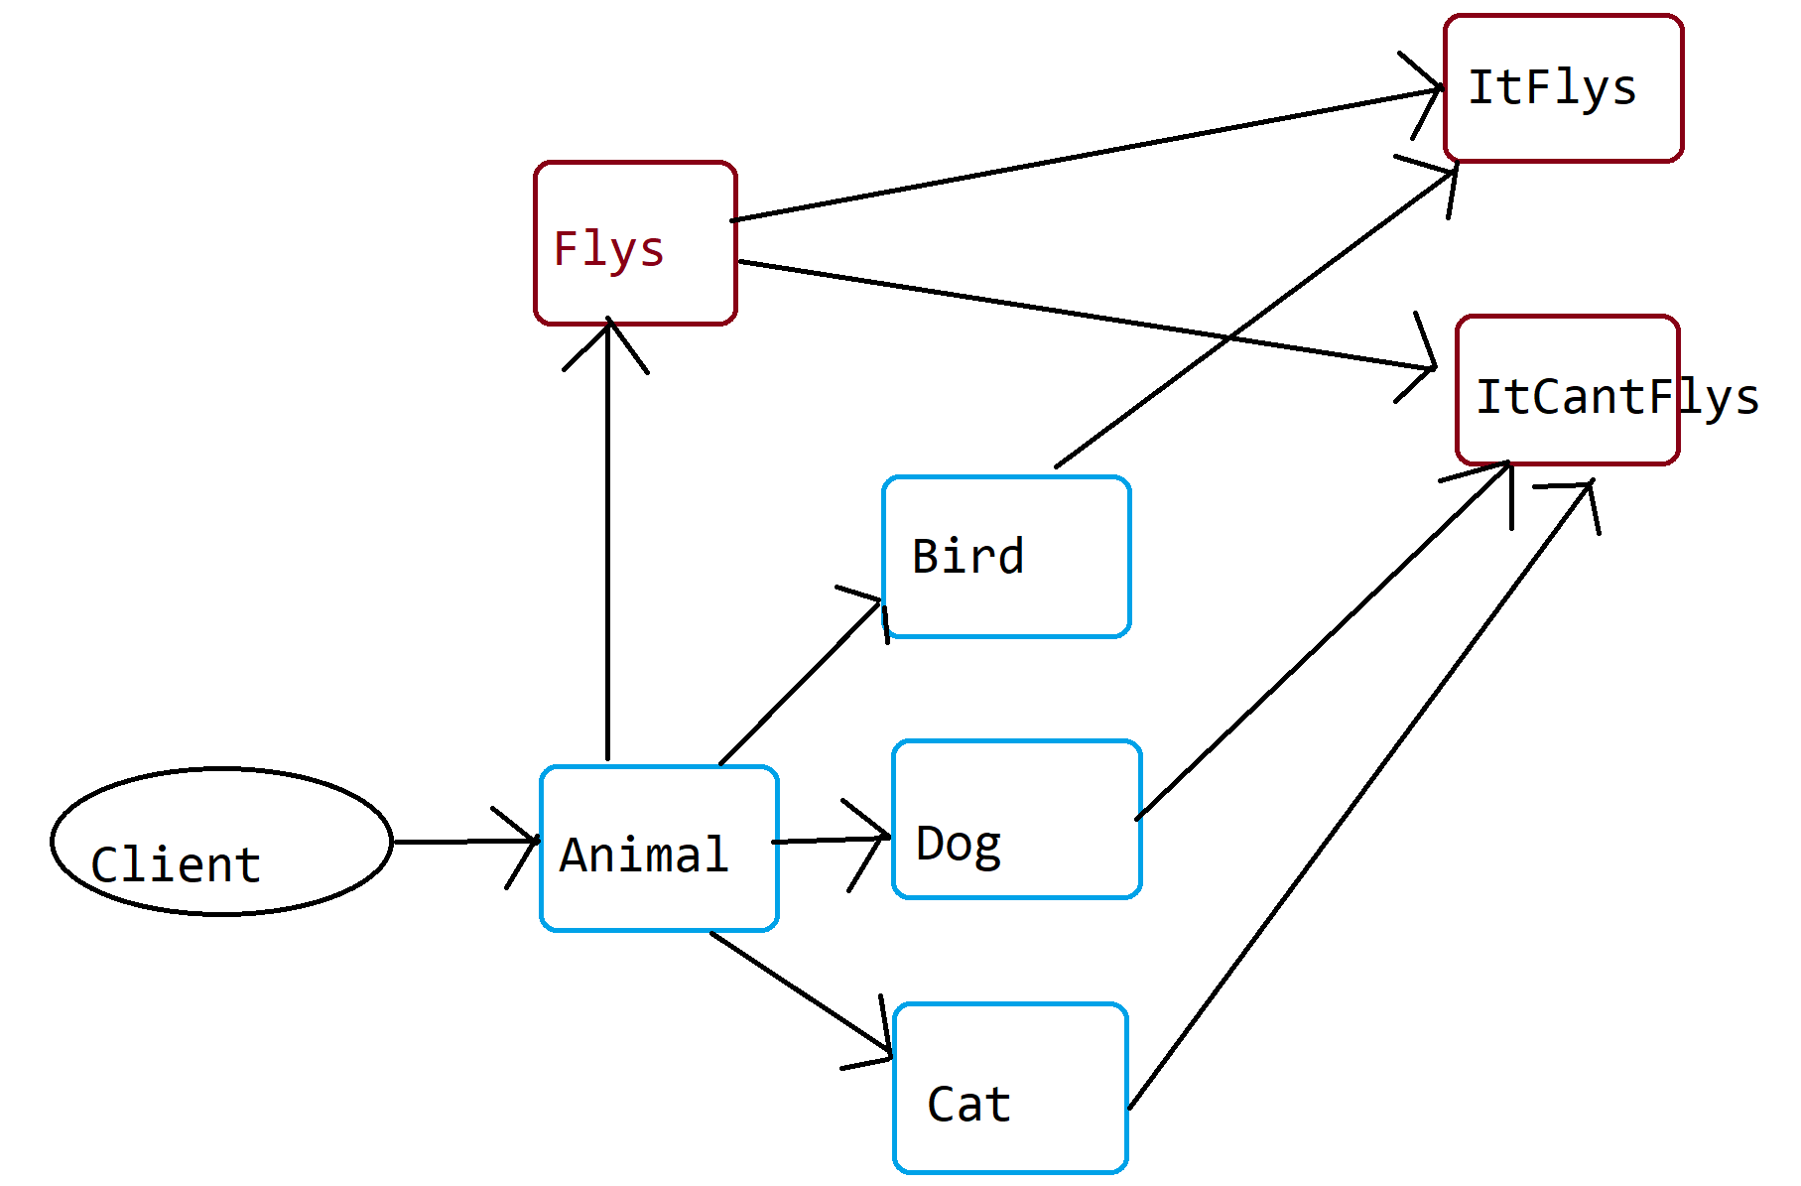
Strategy
In computer programming, the strategy pattern is a behavioral software design pattern that enables selecting an algorithm at runtime.

Slide 45
Use cases
Strategy pattern can be used in payment system. We can have two payment strategy like credit card strategy and paypal strategy and provide the implementation in runtime without code duplicacy.

Slide 46
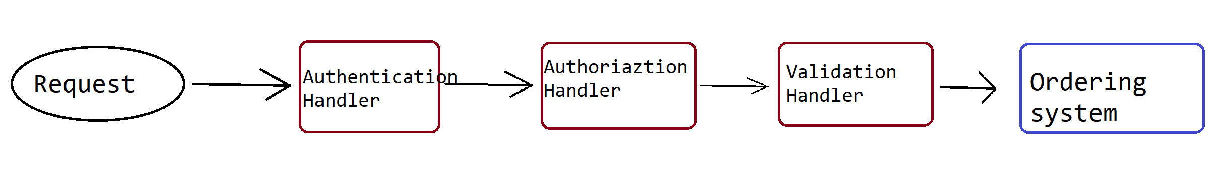
Chain of Responsibility
Chain of Responsibility is a behavioral design pattern that lets you pass requests along a chain of handlers. Upon receiving a request, each handler decides either to process the request or to pass it to the next handler in the chain.

Slide 47
Use cases
order processing system
Problem : complex, less maintainable and less testable pieces of code
Solution: Chain of responsibility can be used to plug and play all the preprocessor components like authentication, authorization, validation and caching that needs to be happened before a request reaches to the order processing system example.
1. If any of the preprocessors failed the request will be dropped immediately.
2. We can change the order of execution of preprocessors anytime.
Another example is devops pipeline steps.

Slide 48
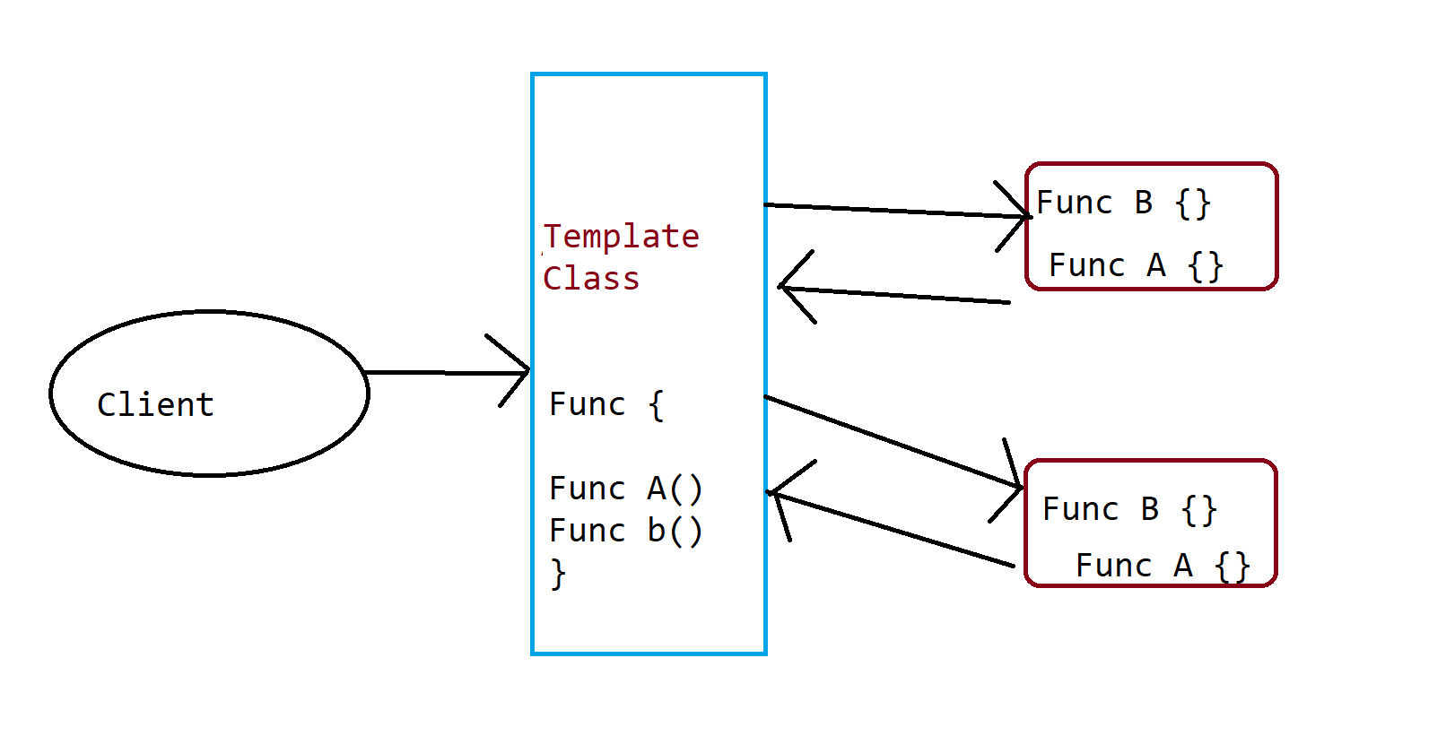
Template
Template Method is a behavioral design pattern that defines the skeleton of an algorithm in the superclass but lets subclasses override specific steps of the algorithm without changing its structure.

Slide 49
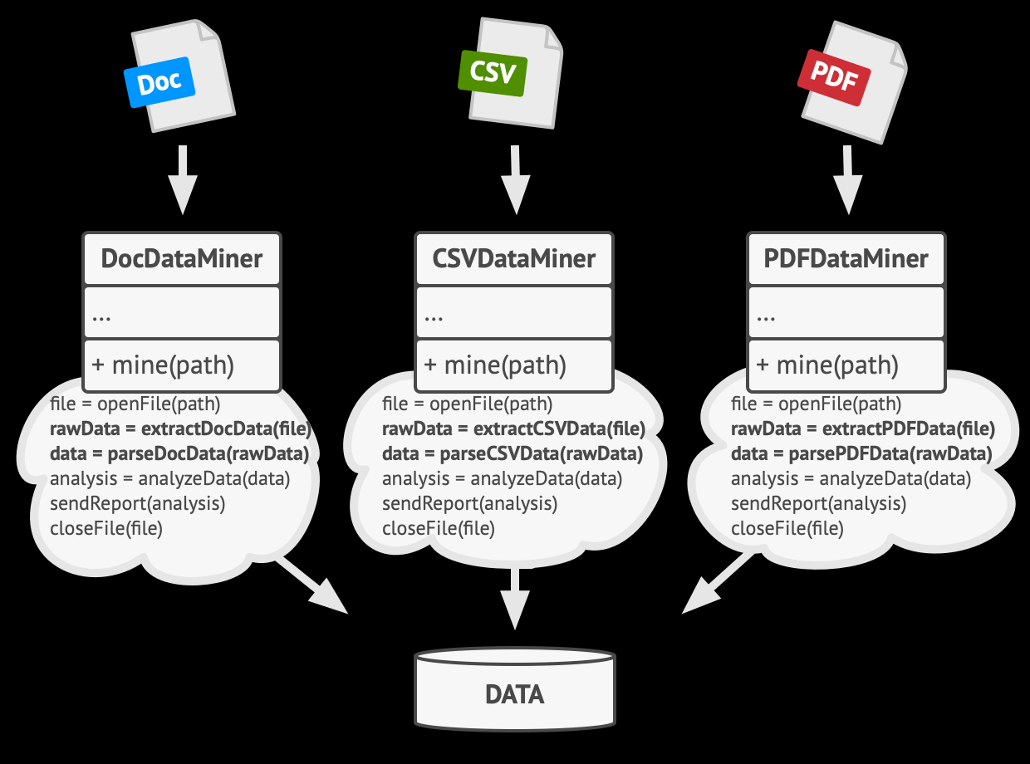
Use cases
Problem :While working on various document data extractor we noticed that all of them does the similar stuff. Would it not nice to separate the common code to remove the code duplication and provide program a structure for all types.

Slide 50
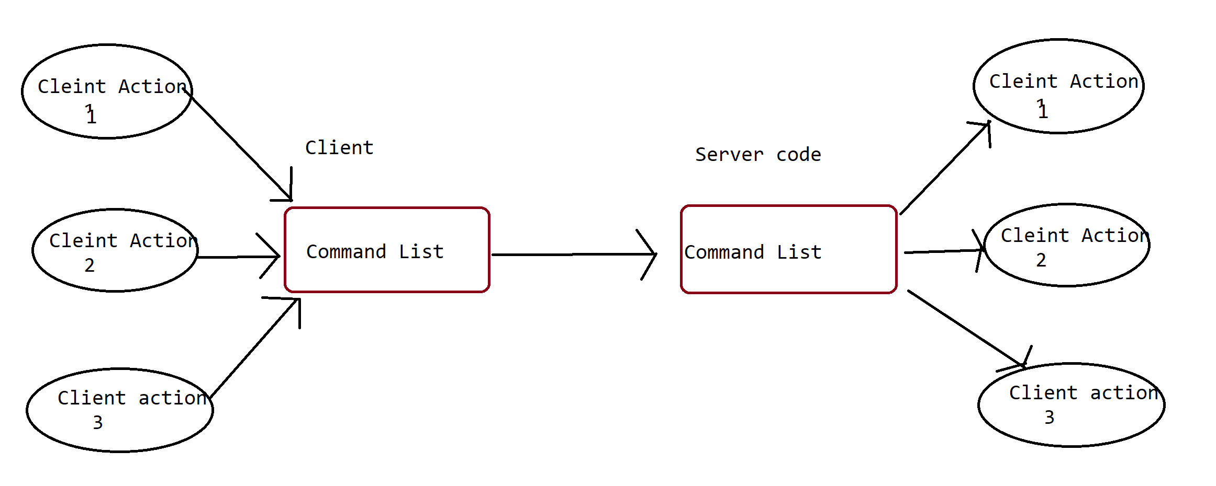
Command
Command is a behavioral design pattern that turns a request into a stand-alone object that contains all information about the request. This transformation lets you pass requests as a method arguments, delay or queue a request’s execution, and support undoable operations.

Slide 51
Use cases
Automized customized pizza creator shop
This application asks user to tell how they like their pizza to be made. We store the order of their pizza component execution and send them to server where same execution happens. We can also store it in our system for future demands.

